Slide 1
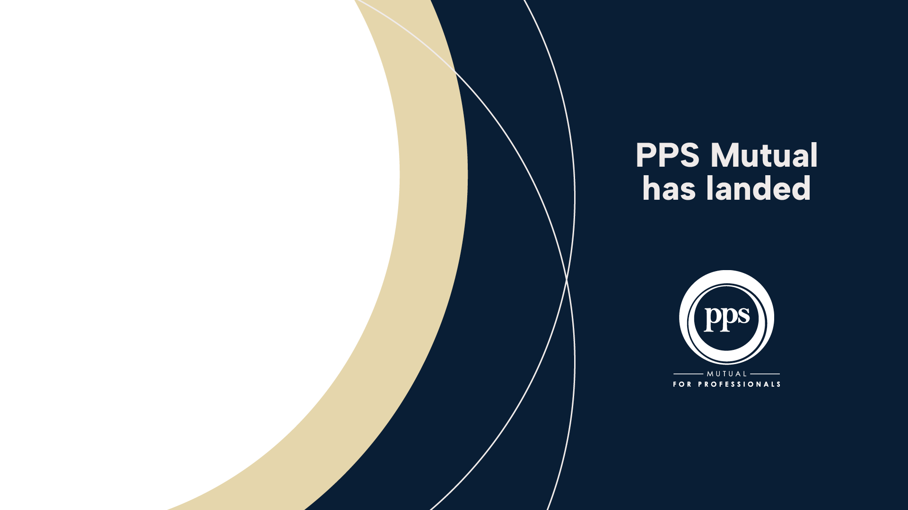


Slide 2
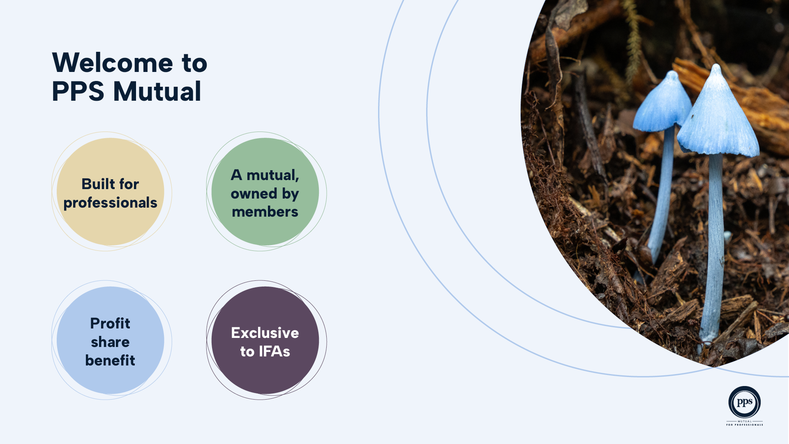
Notes:
PPS Mutual is a member-owned life insurer specialising in the professional market.
They exist for professionals, such as doctors, lawyers, engineers, and other qualified experts – people with demanding careers and unique risk characteristics. They understand the needs of the professional market and their products are designed to reflect the way professionals work, live and plan for the future.
A New Zealand owned and operated mutual company, backed by over 80 years of global experience through the PPS Group in South Africa.
As a mutual, they don’t exist to make profit for external shareholders, they share our financial success directly with our members through our unique Profit Share Benefit.
When it comes to making important financial decisions, they believe in the value of high-quality independent advice. That’s why you can only access a PPS Mutual insurance policy through a select group of accredited independent financial advisers – like me.

Slide 3
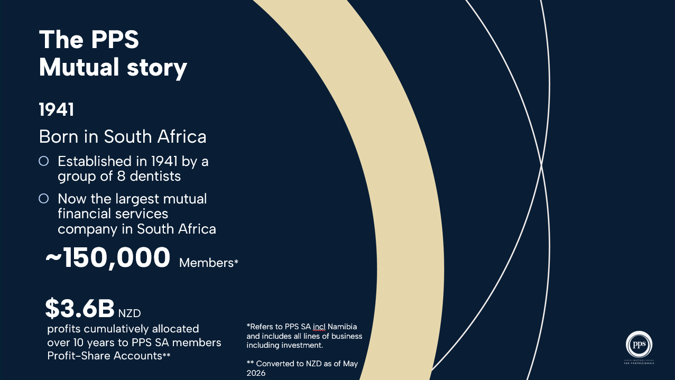
Notes:
The Professional Provident Society of South Africa was founded in 1941 by a group of dentists who believed in a better, fairer model of protection. That belief led to the creation of what is now the largest mutual financial services company in South Africa, trusted by over 150,000 professionals like you.

Slide 4
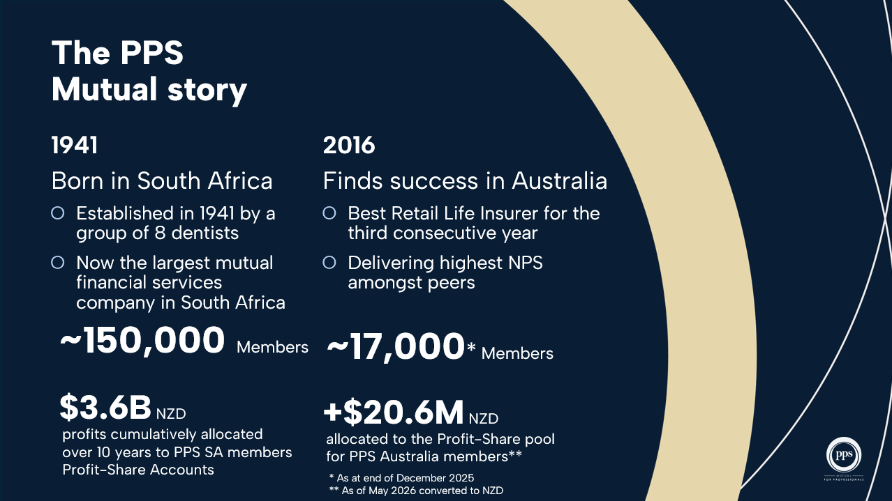
Notes:
Based on the belief that mutuality is the better way to do business, PPS South Africa has shared their proven model for protecting the professional community, with PPS Mutual Australia launching in 2016. PPS Mutual Australia now protects almost 15,000 professionals with life insurance cover designed to meet the needs of the local market.

Slide 5
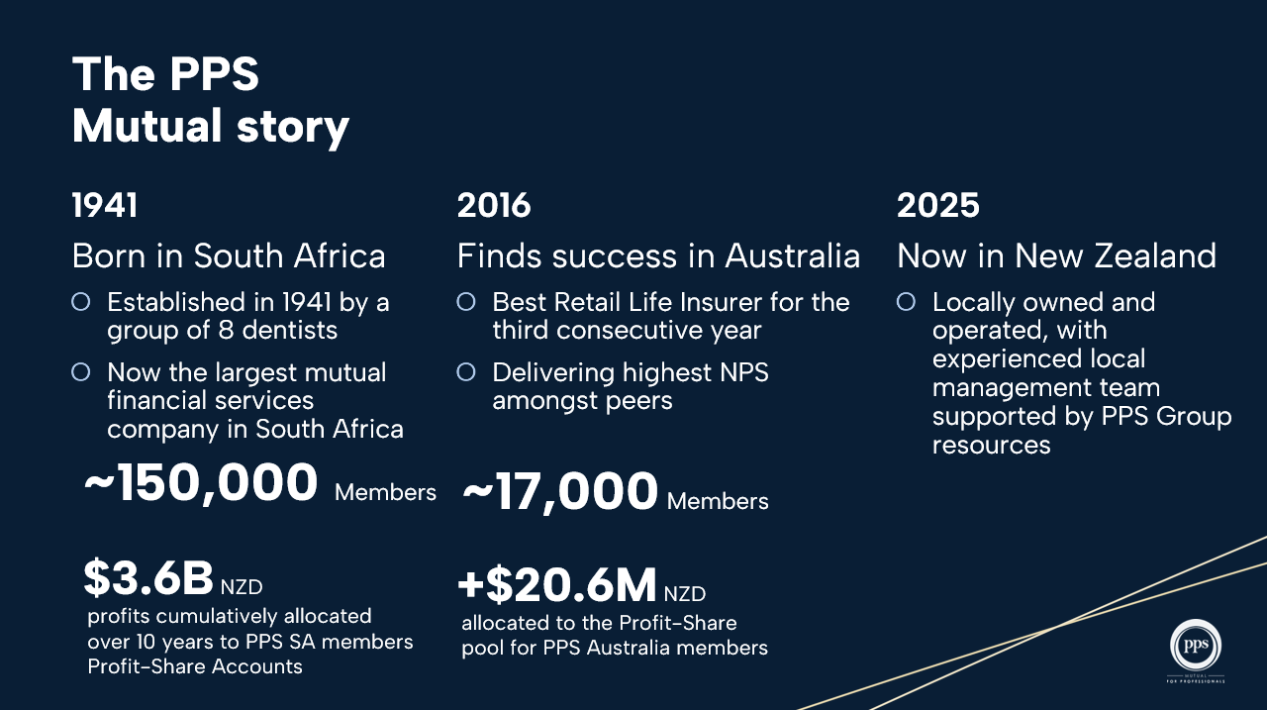
Notes:
Now PPS is bringing the mutual model to New Zealand. The local PPS Mutual team is proud to bring this NZ owned and operated model to Kiwi professionals via our select group of accredited advisers. For those eligible for membership, we offer specialist protection, long-term value, and the opportunity to share in financial success through our Profit Share Benefit.

Slide 6
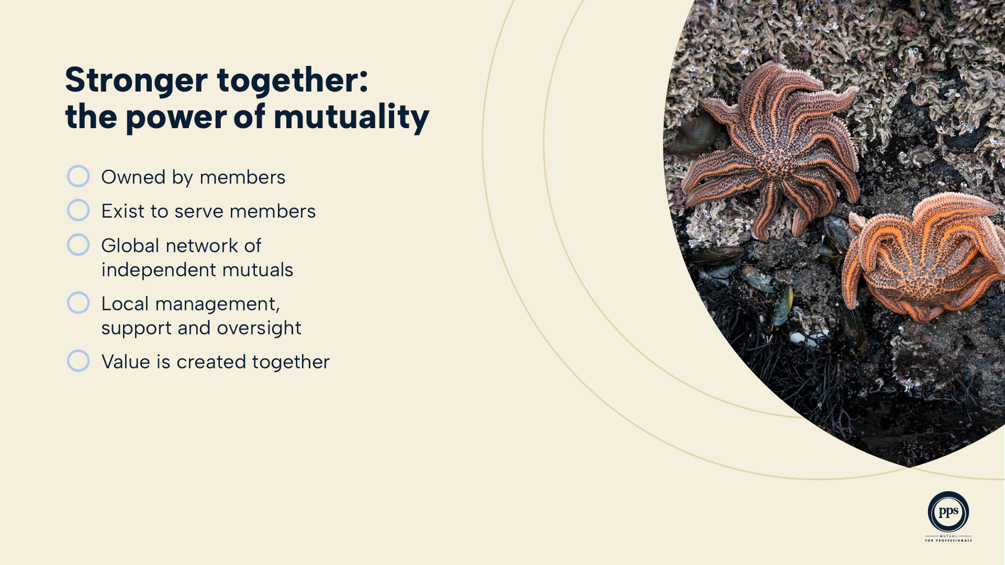
Notes:
As a mutual, PPS is owned by members rather than shareholders. At their core they exist for a single purpose – to serve members and be there when they need us most (Protecting what matters, together). The PPS Group operates as a network of independent mutuals, under a single PPS brand. New Zealand members can take comfort that every decision is made in the best interest of New Zealand members, with local support, management and oversight.

Slide 7
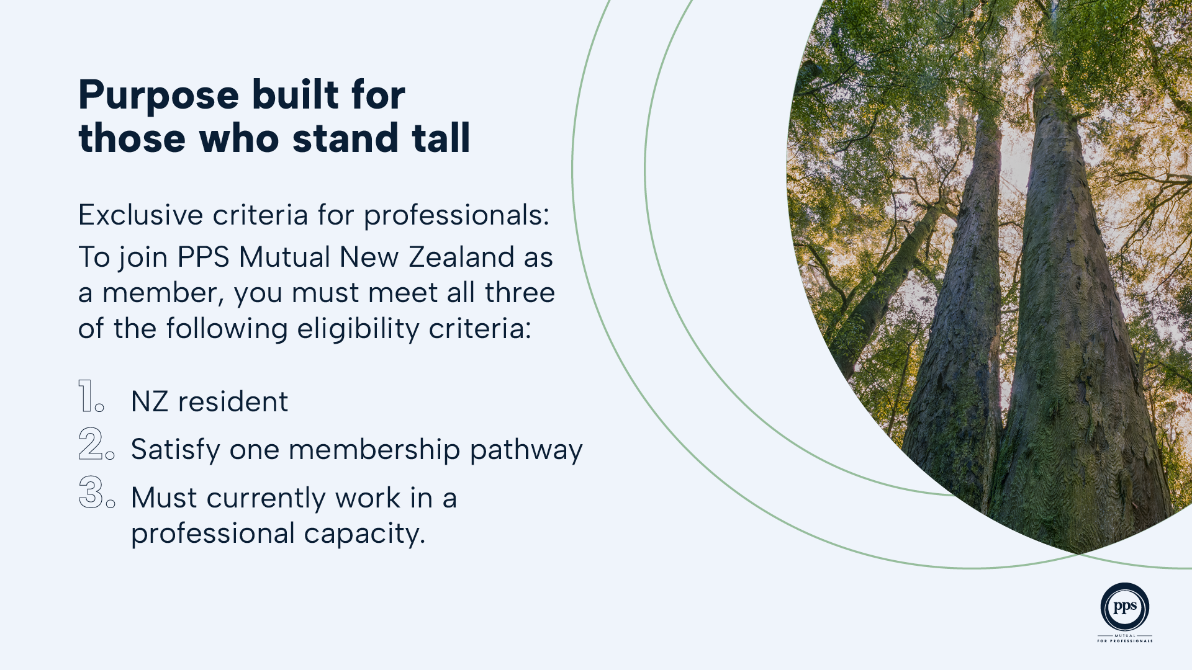
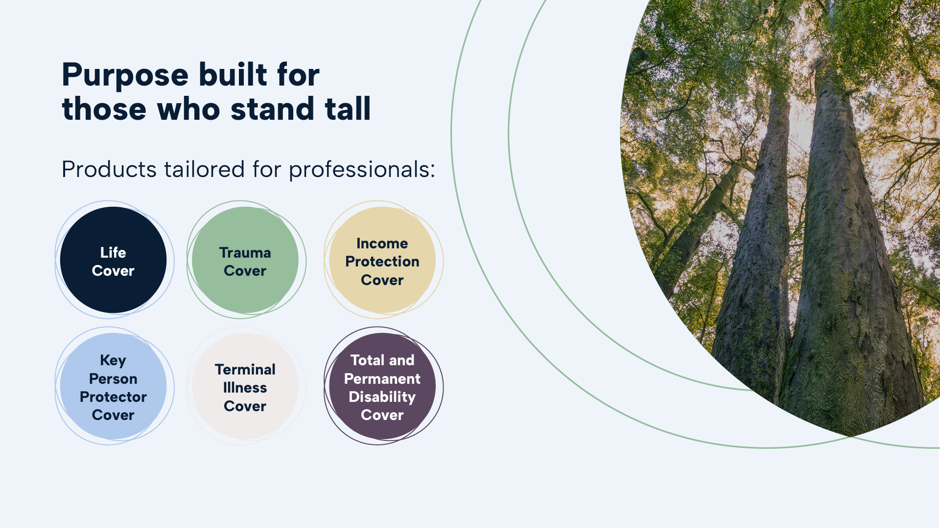
Notes:
To join PPS Mutual New Zealand as a member, you must meet all three of the following eligibility criteria:
1. Be a resident in New Zealand
As a New Zealand citizen, or
As an Australian citizen, or
Under a New Zealand Residence class visa.
2. You must also satisfy one of these membership pathways:
Hold a current membership of at least one of the listed professional bodies (click here for full list), or,
Hold a four-year degree from a globally recognised university that is registered with the Times Higher Education Group (https://www.timeshighereducation.com/world-university-rankings/latest/world-ranking), or,
Hold membership (or prior membership) of PPS Mutual in Australia, South Africa or Namibia.
3. And you must currently work in a professional capacity.
For example, in a role that utilises your professional qualifications or degree.

Slide 8
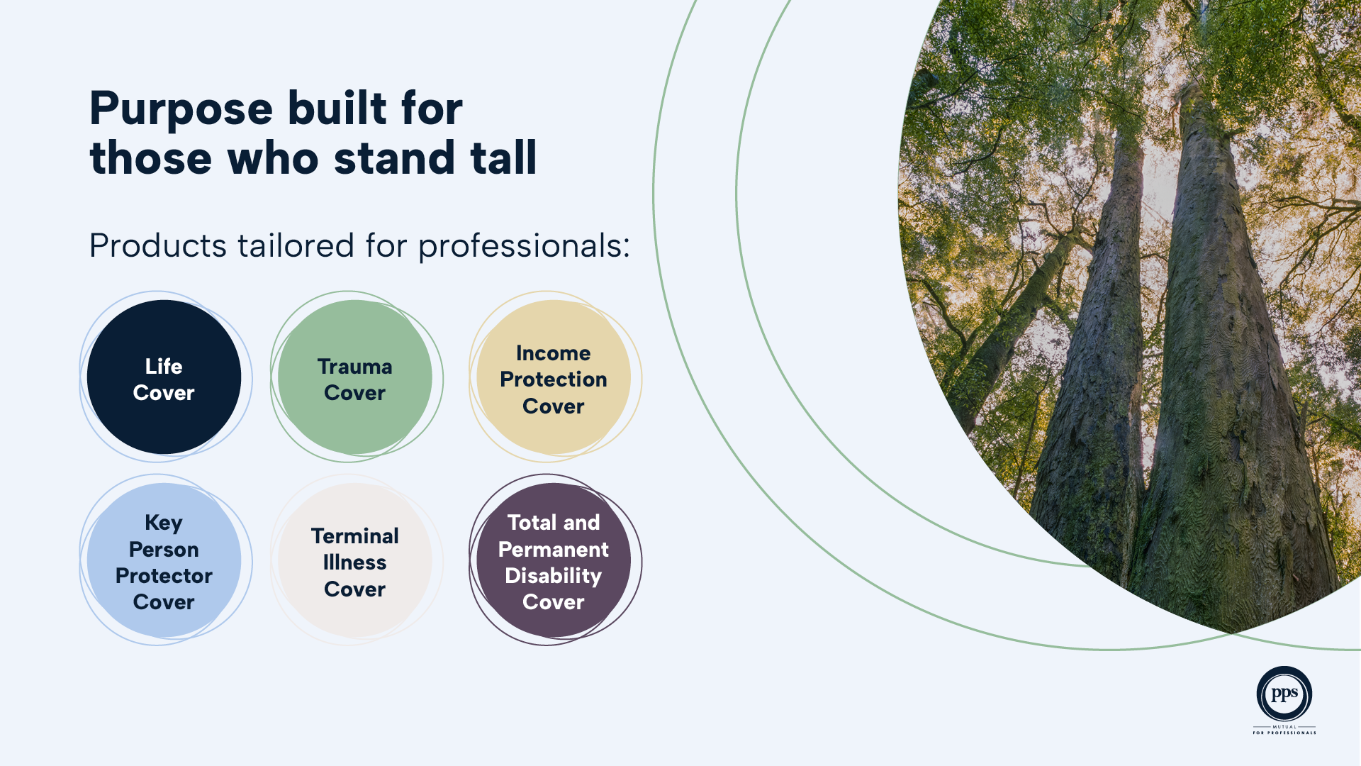
Notes:
PPS Group has been insuring professionals for over 80 years. It is a market they know well and are uniquely positioned to serve. Their modern product suite is designed to cater for the evolving, and often complex, needs of today’s professionals, built with deep insight, global experience and local knowledge in mind. With a proposition focused on protecting professionals like you, you can feel confident knowing you’re sharing risk with like-minded individuals. They don’t try to be everything to everyone.

Slide 9
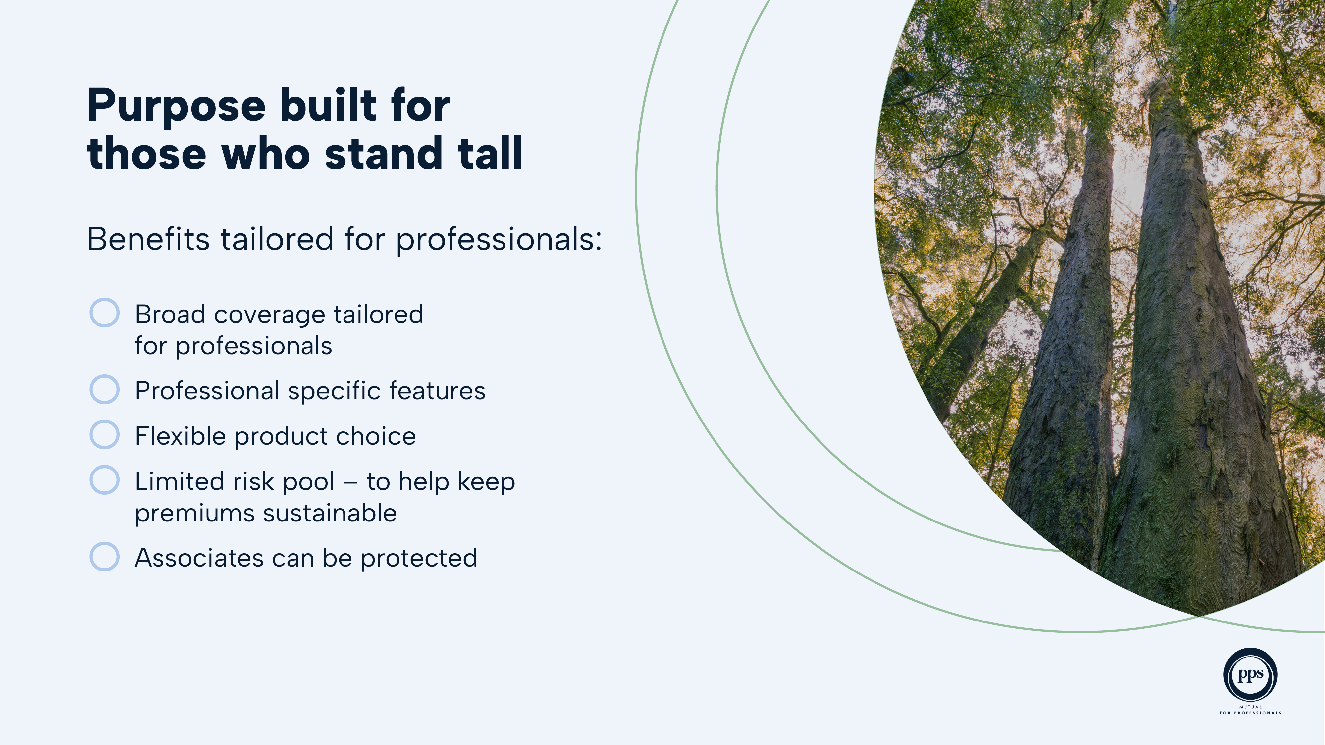
Notes:
Key Features of the PPS Product suite:
Broad coverage that provides customers with greater certainty of outcomes.
Higher financial protection to meet the needs of professionals. Cover limits and underwriting guidelines are specifically for these professionals
Flexible product choice and fair underwriting options to suit customers needs.
Straightforward products and accompanying information to help provide confidence when purchasing insurance.
A great feature of PPS Mutual NZ is that associates can be protected. Associates are classified as spouses, dependant children and key business associates and while they may be insured by PPS Mutual, they are not eligible to receive the Profit Share Benefit which is exclusively for members.

Slide 10
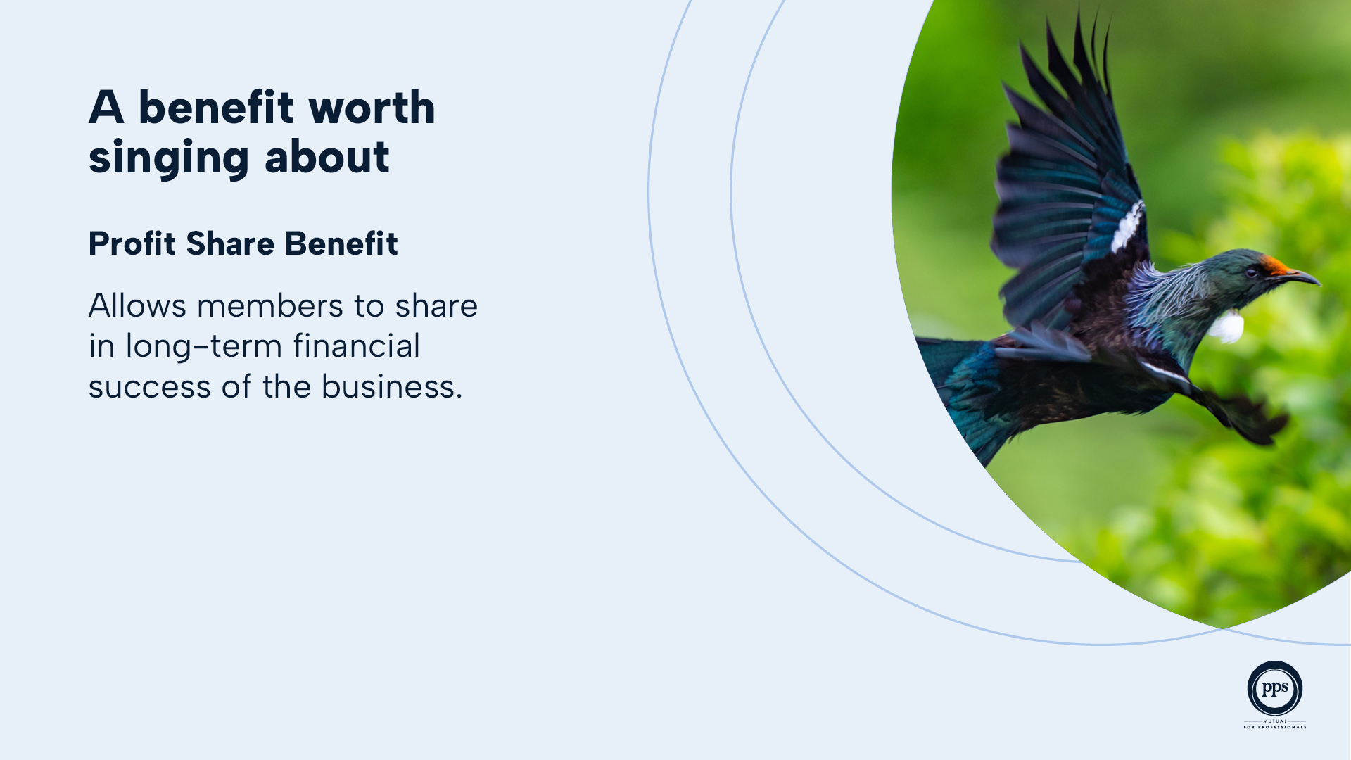
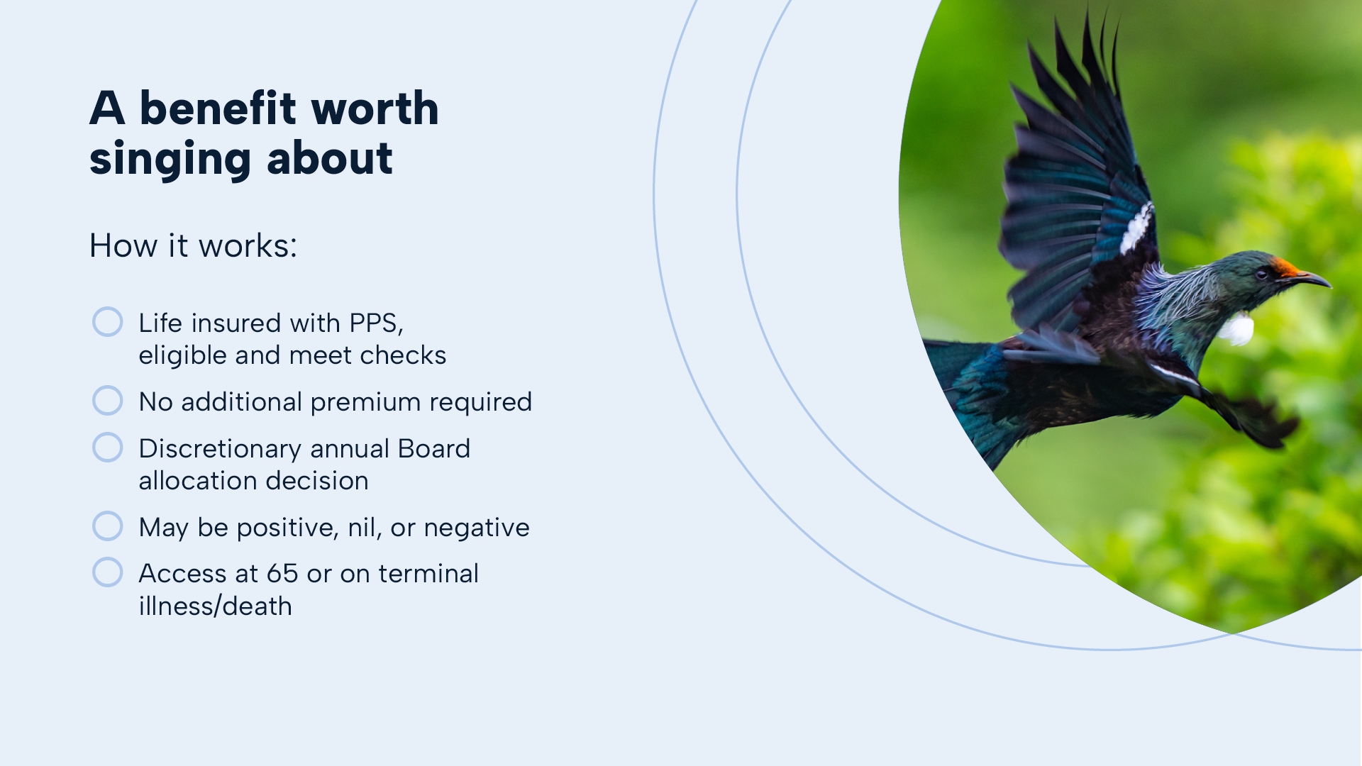
Notes:
One of the most distinctive benefits of PPS Mutual is that it pays to be a member. Unlike most modern insurers, PPS Mutual is owned by its members – which means they don’t just provide high-quality life cover and protection, they also share our success. Each year, eligible members receive an allocation to their Profit Share Benefit based on the financial success of the business and other factors, including the premiums paid on your life under our Professionals’ Choice policy, rewarding loyalty and long-term commitment with meaningful value.
For detailed information make sure you read the Profit Share Benefit Information Sheet which is available on the PPS Mutual website.

Slide 11
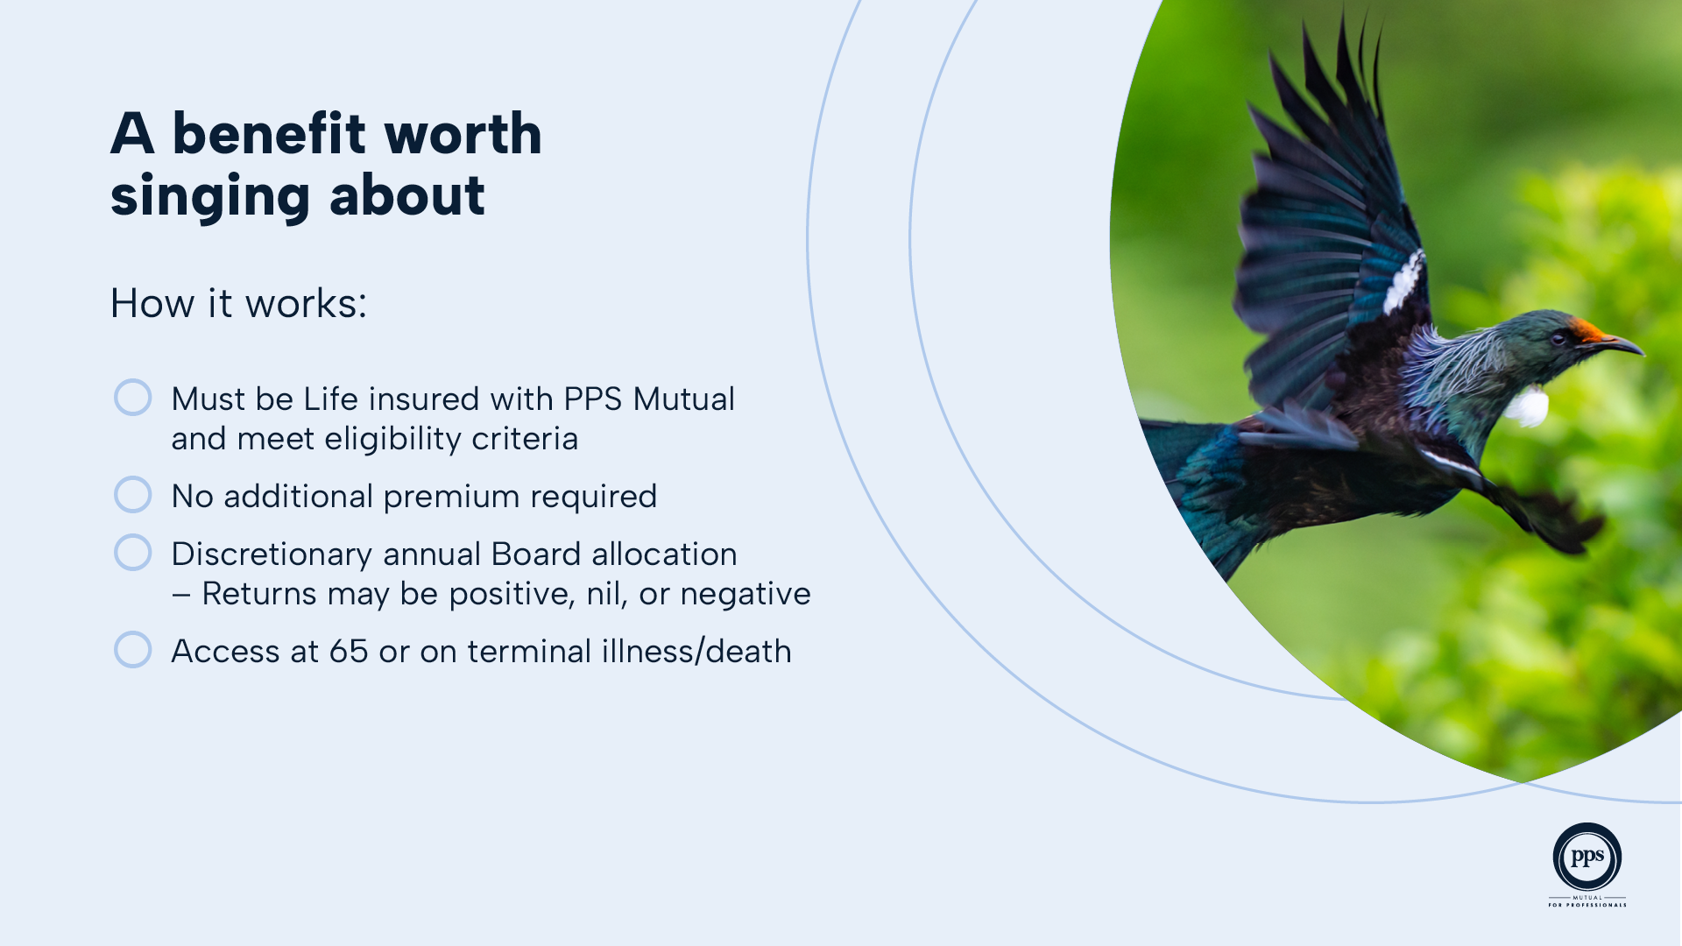

Notes:
How it works:
When you join PPS Mutual as a member by meeting the eligibility requirements, you are eligible to receive a Profit Share Benefit.
There is no additional premium required. Each year, the Board of PPS Mutual may exercise its discretion to make a Profit Share Benefit allocation to members based on the financial performance of the PPS Mutual business, investment earnings on assets supporting Profit Share Benefits, and the capital needs of the business.
Profit Share Benefit allocations are discretionary and expected to change over time. Allocations may be positive, nil, or negative, which means that your Profit Share Benefit may change after each allocation is made.
If you cancel your PPS Mutual insurance policy, your Profit Share Benefit may be reallocated to other PPS Mutual members unless you have been a member for at least five years and your Profit Share Benefit exceeds $1,000.

Slide 12


